Slide 1

3. Covariances
Dr. David R. Thompson
Jet Propulsion Laboratory, Imaging Spectroscopy Group
July 20, 2019

Slide 2
Goals for this module
Know the “curse of dimensionality”
Recognize the multivariate Gaussian and know its mathematical properties
Estimate well-conditioned covariance matrices from spectroscopic data
Calculate, interpret, and use principal component (PCA) projections

Slide 3
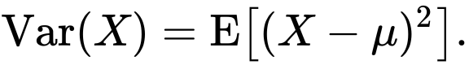
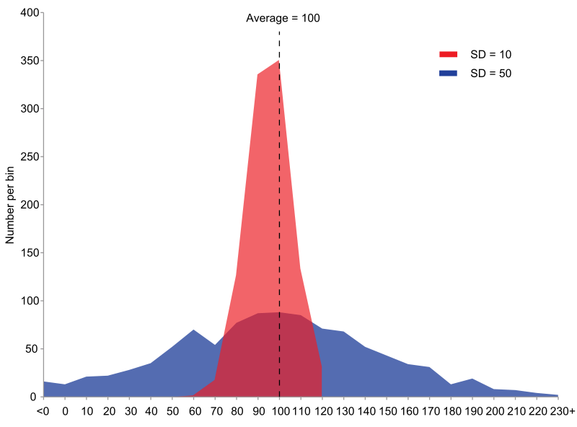
For one variable, the variance describes the spread of the data.
Image: wikimedia

Slide 4
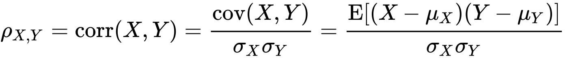
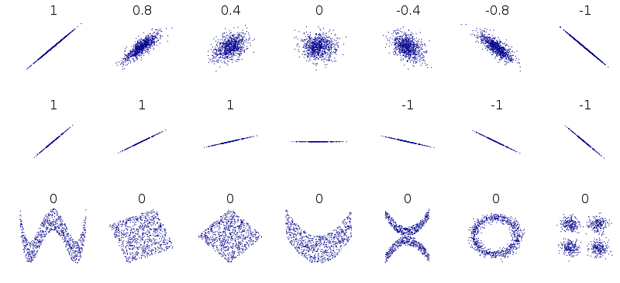
For two variables, the covariance describes the linear relationship.
Normalized, it is the correlation coefficient.
Image: wikimedia

Slide 5
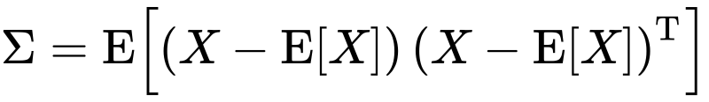

For vector-valued data, the covariance matrix has the covariance between all elements.
Diagonals hold the variance of each variable.
channel 2
$$Σ=\left[\begin{matrix}0.74 & 0.11 \\ 0.11 & 0.17\end{matrix}\right]$$
Off-diagonals describe correlations.
channel 1

Slide 6
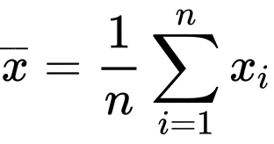
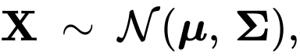
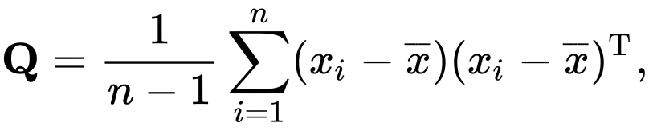
To estimate it from data, start with the mean:
( Note: we also use the symbol )
… defining a “sample covariance”:
Credit: wikimedia

Slide 7
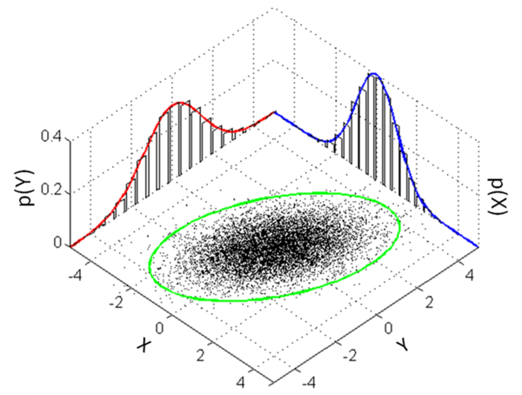
The mean and covariance define a multivariate Gaussian probability distribution.
Credit: wikimedia

Slide 8
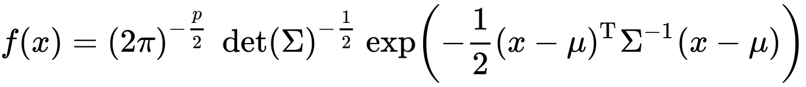
The multivariate Gaussian has a normalized probability density:
Normalization so that PDF integrates to unity
Squared distance to center accounting for covariance
Inverse covariance matrix
(i.e. the precision matrix)
Problem: high-dimensional covariances may be nearly singular.
Credit: wikimedia

Slide 9
Problem: high-dimensional data is often singular.
channel 2
Nominal dimensionality: 2
Intrinsic dimensionality: 1
Not invertible!
channel 1

Slide 10
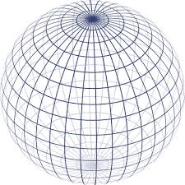
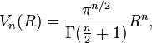
This is related to the curse of dimensionality: Volume of an N-Ball
Inscribed within a hypercube

Slide 11
As dimensions increase … Euclidean distances become less meaningful Uniform distributions become exponentially harder to sample Many parameters become polynomially harder to estimate (e.g. covariances) Data becomes more difficult to visualize

Slide 12
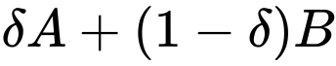
Solution 1: Condition the sample covariance to make it nonsingular.
A common method is shrinkage regularization:
A small coefficient
To control the amount of regularization
Original sample covariance
Shrinkage target, e.g. identity matrix
Credit: wikimedia

Slide 13
Solution 2: work in a lower dimensional representation A good one is the linear subspace spanned by the process you are measuring. Principal Component Analysis determines a compact representation for the data – a linear projection that maximizes the variances (i.e. the spread) of the projected dataset.

Slide 14
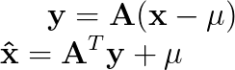
PCA Recipe
Convert the data to have zero mean
Form A using the top n eigenvectors of the sample covariance matrix XX^{T}
Equivalently, use the left singular vectors of X associated with the largest singular values
Project the data:
To reconstruct:

Slide 15
First 5 PCA dimensions of the of Cuprite Nevada mining district (AVIRIS-NG)
[Thompson et al., Astrobiology 2019]

Slide 17
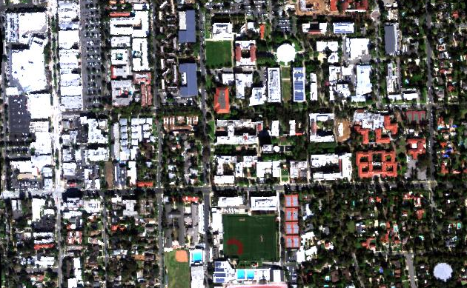
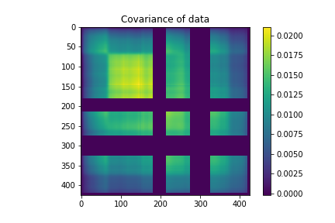
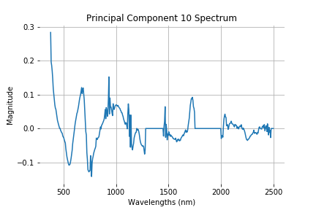
Exercise 3: Principal Component Analysis
N
100 m
Objective: Calculate Principal Components of the Caltech cube. Calculate mean spectra and the covariance matrix. Watch out for deep water features and bad data flags (values of -9999) at the periphery. You may not need all spectra in the calculation. Are any of the top PCs interpretable? If so, what do they represent?

